Slide 1
Subgroup analysis
Li Zhu, Yusi Fang, Peng Liu
12/18/2019
Group meeting

Slide 2

Why are we talking about Precision Medicine?
In 2015, All of US (previously known as the precision medicine initiative) was created with $215 million in funding that aimed to make advances in tailoring medical care to the individuals.
By Jan 2018, an initial pilot project has enrolled 10k people and 2022 was targeted for 1 million people (https://allofus.nih.gov/).

Slide 3
Why are we talking about subgroup analysis?
Subgroup analysis which aims to assess the heterogeneity of the treatment effect is an essential step towards precision medicine.
Currently, majority of subgroup analyses are conducted in clinical trial studies, mostly ignoring the effect of genomics data on treatment effect.
We (including Yusi and Peng) are trying to start a project to study how genomics profiles, together with other clinical variables, influence the treatment effect.

Slide 4
Outline
Introduce subgroup analysis, including the commonly used methods and the challenges (Wang and Ware, ﻿Prevention Research, 2013)
Review some of the existing methods
Introduce our proposal

Slide 5
Definition of subgroup analysis
Subgroup analysis: any comparison of patient outcomes between treatment groups across subsets of patients defined by patient characteristics.
Subgroups are often defined by baseline factors, so the question becomes whether treatment effect varies among the levels of the baseline factor, a.k.a. “moderator analysis” in social science.
Two requirements of being a moderator:
Eligibility: a variable precede treatment in time and is uncorrelated with treatment
Analytical criteria: demonstration of treatment effect heterogeneity across levels of the grouping variable, a.k.a “effect modification” by epidemiologists

Slide 6
Types of subgroup analysis
Hypothesis-generating subgroup analysis
whether the treatment effect is consistent across subgroups?
Requires further validation in future studies
Hypothesis-testing subgroup analysis
how effects of a new treatment vary according to a baseline factor identified a priori
Motivated by a previous study
Plans for subgroup analyses should be considered during the design of a study.
Use stratified randomization of treatment assignments to ensure sufficient representation in the subgroup of interest to guarantee adequate power.

Slide 7
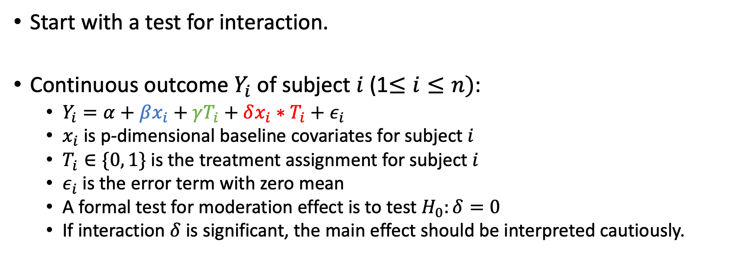
Methods for conducting subgroup analysis
Baseline effect
Main effect of treatment
Baseline treatment interaction
Start with a test for interaction.
Continuous outcome $Y_{i}$ of subject $i$ (1$≤i≤n)$:
$Y_{i}=α+βx_{i}+γT_{i}+δx_{i}∗T_{i}+ε_{i}$
$x_{i}$ is p-dimensional baseline covariates for subject $i$
$T_{i}∈\{0, 1\}$ is the treatment assignment for subject $i$
$ε_{i}$ is the error term with zero mean
A formal test for moderation effect is to test $H_{0}:δ=0$
If interaction $δ$ is significant, the main effect should be interpreted cautiously.

Slide 8
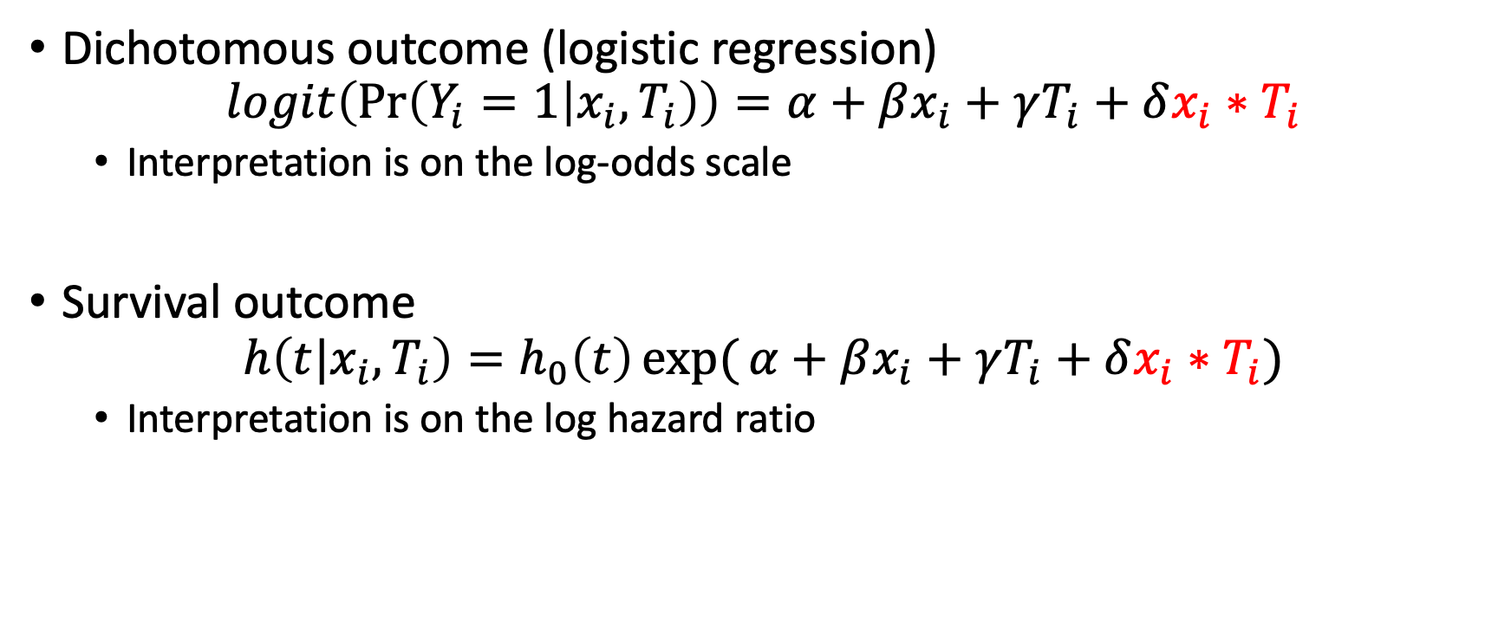
Dichotomous and survival outcomes
Dichotomous outcome (logistic regression)
$$logit\left(\operatorname{Pr}\left(Y_{i}=1 | x_{i},T_{i}\right)\right)=α+βx_{i}+γT_{i}+δx_{i}∗T_{i}$$
Interpretation is on the log-odds scale
Survival outcome
$$h\left(t|x_{i},T_{i}\right)=h_{0}\left(t\right)\exp{(}α+βx_{i}+γT_{i}+δx_{i}{∗T}_{i})$$
Interpretation is on the log hazard ratio

Slide 9
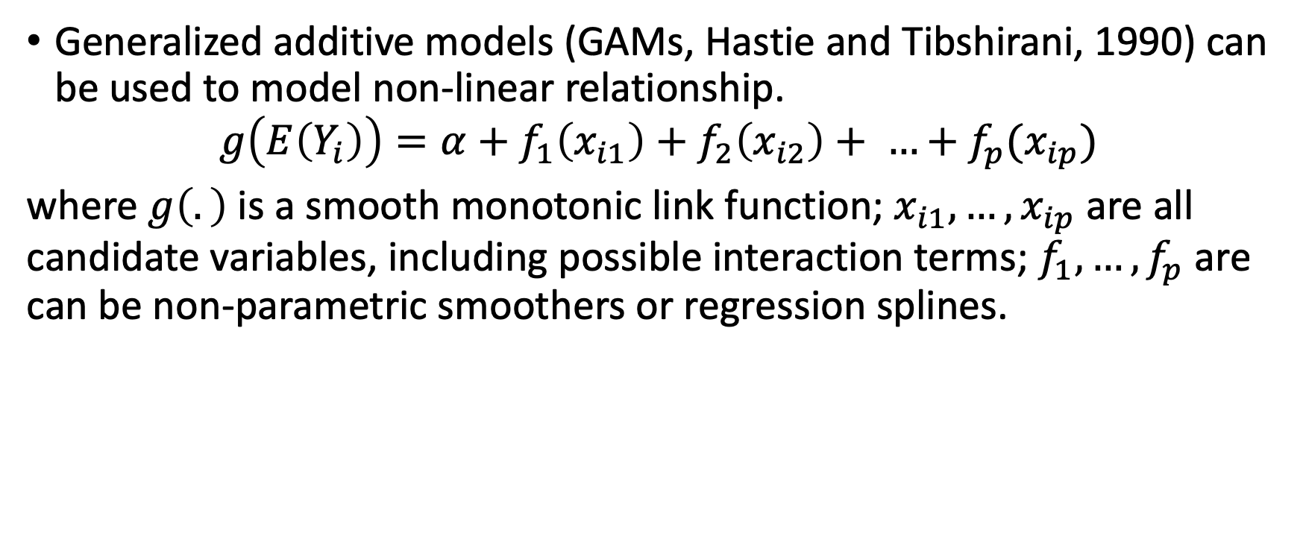
Non-linear relationship of baseline variables
Generalized additive models (GAMs, Hastie and Tibshirani, 1990) can be used to model non-linear relationship.
$$g\left(E\left(Y_{i}\right)\right)=α+f_{1}\left(x_{i1}\right)+f_{2}\left(x_{i2}\right)+ …+f_{p}(x_{ip})$$
where $g\left(.\right)$ is a smooth monotonic link function; $x_{i1},…, x_{ip}$ are all candidate variables, including possible interaction terms; $f_{1}, …, f_{p}$ are can be non-parametric smoothers or regression splines.

Slide 10
Quantitative and qualitative interactions
Quantitative interaction: treatment effects are in the same directions but different magnitudes
Qualitative interaction: treatment effects are in different directions
Several test have been proposed specifically to assess qualitative interaction: likelihood ratio test (Gail and Simon 1985), range test (Piantadosi and Gail 1993), test based on simultaneous confidence intervals (Pan and Wolfe 1997), etc. Sometimes, likelihood ratio test is not the most powerful test.

Slide 11
Subgroup analysis based on post-baseline factors
Subgroup analysis based on post-baseline factors is more complicated, as group membership can be affected by treatment.
Post-baseline factors validate the temporal criteria, thus it cannot be seen as moderators. But they may explain how and why treatment affects outcome and be considered as mediators.

Slide 12
Moderator vs mediator
Moderator: a variable affects the director/strength of the relation between independent and dependent variables
Mediator: a variable accounts for the relation between independent and dependent variables
E.g., the relation between social class and frequency of breast self-exams, age might be a moderator, education might be a mediator
Moderator: age
Social class
Frequency of breast self-exam
Mediator: education

Slide 13
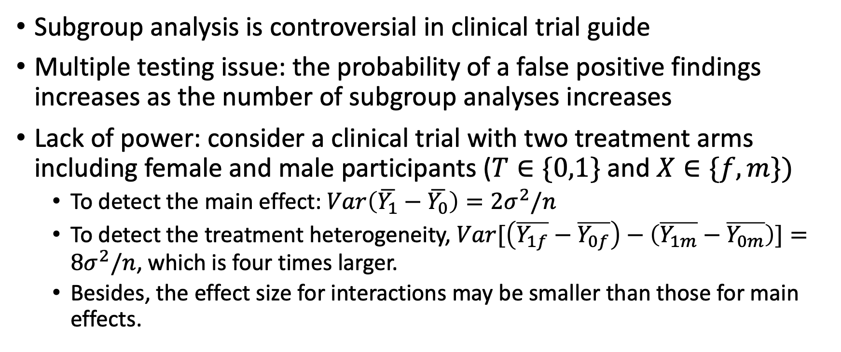
Challenges
Subgroup analysis is controversial in clinical trial guide
Multiple testing issue: the probability of a false positive findings increases as the number of subgroup analyses increases
Lack of power: consider a clinical trial with two treatment arms including female and male participants ($T∈\{0,1\}$ and $X∈\{f, m\})$
To detect the main effect: $Var\left(\overline{Y_{1}}−\overline{Y_{0}}\right)=2σ^{2}/n$
To detect the treatment heterogeneity, $Var[\left(\overline{Y_{1f}}−\overline{Y_{0f}}\right)−\left(\overline{Y_{1m}}−\overline{Y_{0m}}\right)]=8σ^{2}/n$, which is four times larger.
Besides, the effect size for interactions may be smaller than those for main effects.

Slide 14
Part2. Some existing methods
I grouped the methods into three categories:
Model interactions
Model subgroups as latent classes
Directly optimize treatment decision rule

Slide 15
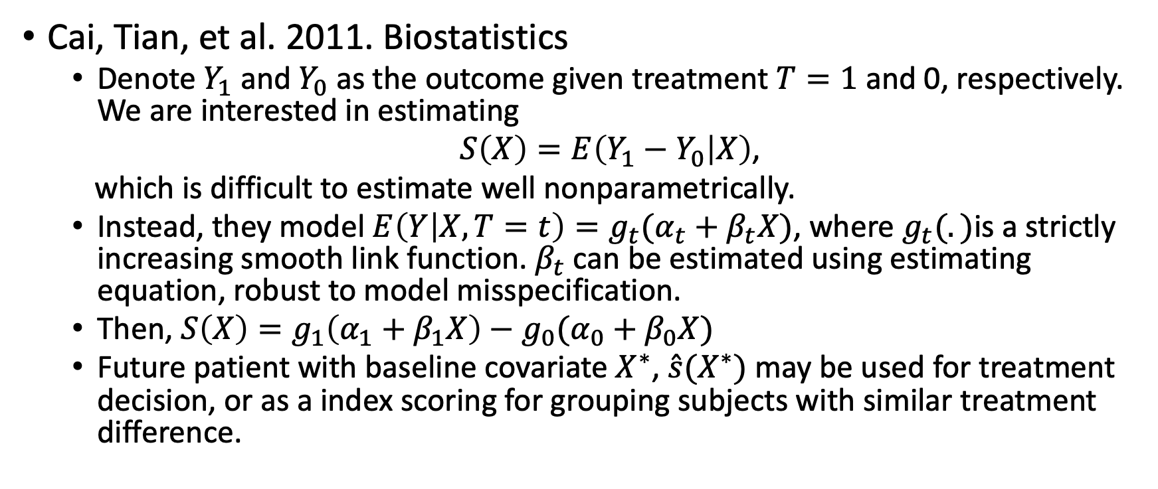
(1) Model the interactions
Cai, Tian, et al. 2011. Biostatistics
Denote $Y_{1}$ and $Y_{0}$ as the outcome given treatment $T=1$ and 0, respectively. We are interested in estimating
$S\left(X\right)=E\left(Y_{1}−Y_{0} | X\right)$,
which is difficult to estimate well nonparametrically.
Instead, they model $E\left(Y | X, T=t\right)=g_{t}({α_{t}+β}_{t}X)$, where $g_{t}(.)$is a strictly increasing smooth link function. $β_{t}$ can be estimated using estimating equation, robust to model misspecification.
Then, $S\left(X\right)=g_{1}\left(α_{1}+β_{1}X\right)−g_{0}(α_{0}+β_{0}X)$
Future patient with baseline covariate $X^{∗}$, $\hat{s}(X^{∗})$ may be used for treatment decision, or as a index scoring for grouping subjects with similar treatment difference.

Slide 16
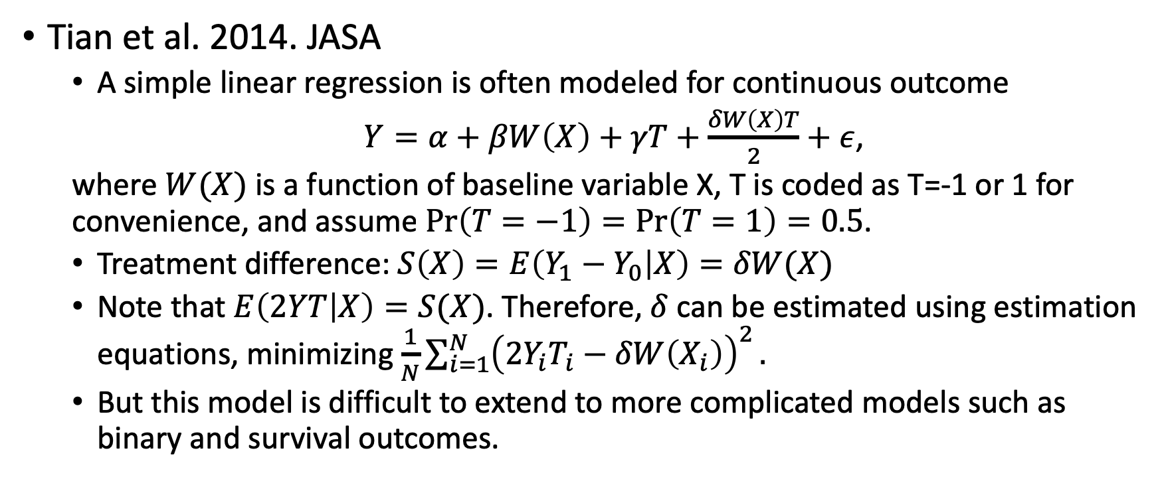
(1) Model the interactions (cont’d)
Tian et al. 2014. JASA
A simple linear regression is often modeled for continuous outcome
$Y=α+βW\left(X\right)+γT+\frac{δW\left(X\right)T}{2}+ε$,
where $W(X)$ is a function of baseline variable X, T is coded as T=-1 or 1 for convenience, and assume $\operatorname{Pr}\left(T=−1\right)=\operatorname{Pr}\left(T=1\right)=0.5$.
Treatment difference: $S\left(X\right)=E\left(Y_{1}−Y_{0} | X\right)=δW(X)$
Note that $E\left(2YT | X\right)=S(X)$. Therefore, $δ$ can be estimated using estimation equations, minimizing $\frac{1}{N}\sum_{i=1}^{N}{{\left(2Y_{i}T_{i}−δW\left(X_{i}\right)\right)}^{2}}.$
But this model is difficult to extend to more complicated models such as binary and survival outcomes.

Slide 17
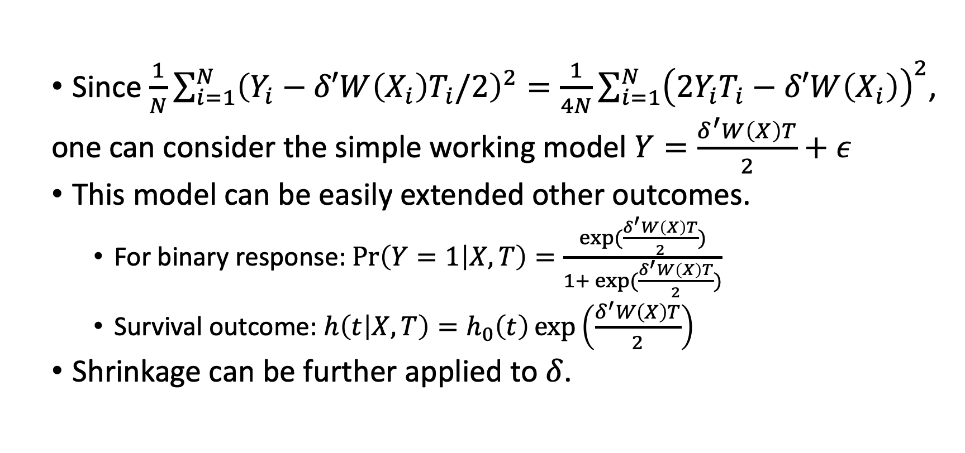
Tian et al. 2014. JASA cont’d
Since $\frac{1}{N}\sum_{i=1}^{N}{{\left(Y_{i}−δ′W\left(X_{i}\right)T_{i}/2\right)}^{2}}=\frac{1}{4N}\sum_{i=1}^{N}{{\left(2Y_{i}T_{i}−δ′W\left(X_{i}\right)\right)}^{2}}$,
one can consider the simple working model $Y=\frac{δ^{′}W\left(X\right)T}{2}+ε$
This model can be easily extended other outcomes.
For binary response: $Pr\left(Y=1 | X, T\right)=\frac{exp⁡(\frac{δ^{′}W\left(X\right)T}{2})}{1+ exp⁡(\frac{δ^{′}W\left(X\right)T}{2})}$
Survival outcome: $h\left(t | X, T\right)=h_{0}\left(t\right)\exp\left(\frac{δ^{′}W\left(X\right)T}{2}\right)$
Shrinkage can be further applied to $δ$.

Slide 18
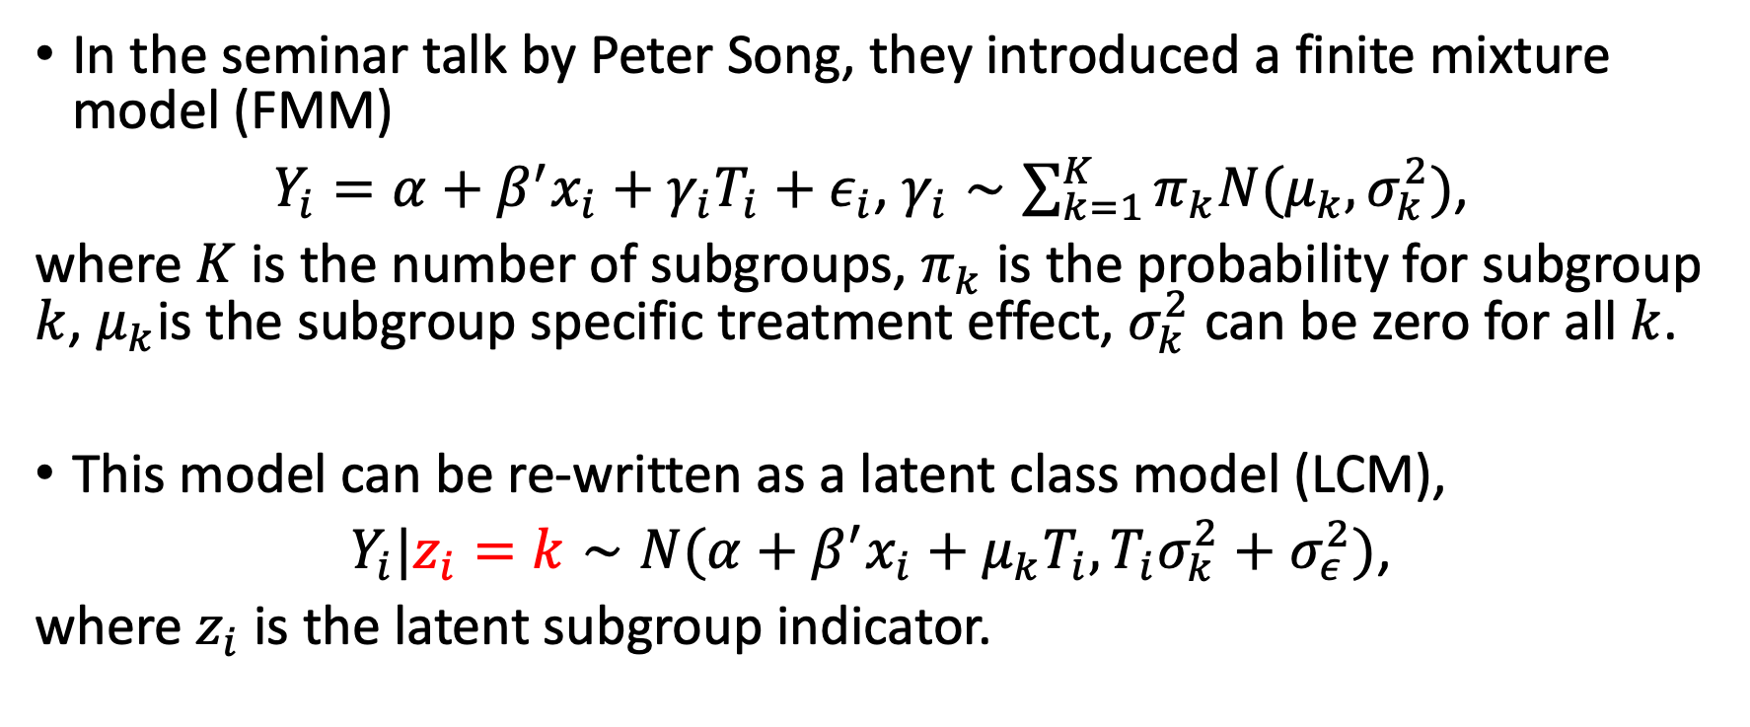
(2) Model subgroup as latent class
In the seminar talk by Peter Song, they introduced a finite mixture model (FMM)
$Y_{i}=α+β^{′}x_{i}+γ_{i}T_{i}+ε_{i}$, $γ_{i}∼\sum_{k=1}^{K}{{π_{k}N(μ}_{k}, σ_{k}^{2})}$,
where $K$ is the number of subgroups, $π_{k}$ is the probability for subgroup $k$, $μ_{k}$is the subgroup specific treatment effect, $σ_{k}^{2}$ can be zero for all $k$.
This model can be re-written as a latent class model (LCM),
$Y_{i}|z_{i}=k∼N(α+β^{′}x_{i}+μ_{k}T_{i}, T_{i}σ_{k}^{2}+σ_{ε}^{2})$,
where $z_{i}$ is the latent subgroup indicator.

Slide 19
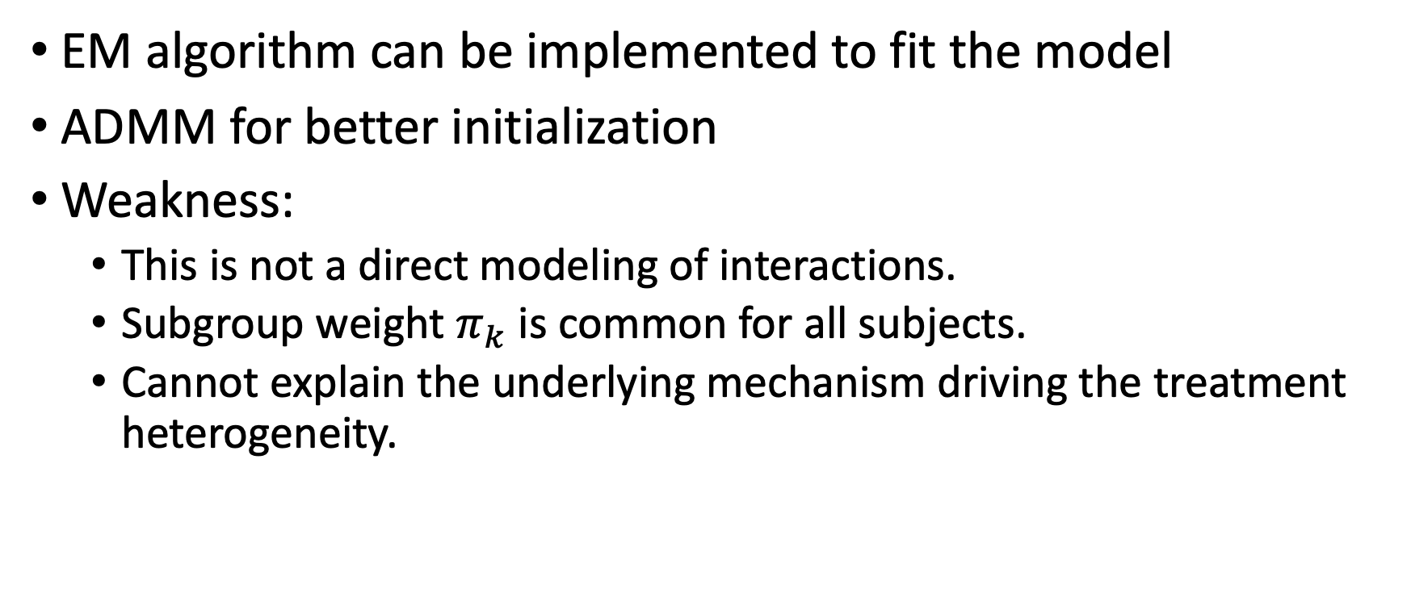
Peter Song (2018, seminar talk) cont’d
EM algorithm can be implemented to fit the model
ADMM for better initialization
Weakness:
This is not a direct modeling of interactions.
Subgroup weight $π_{k}$ is common for all subjects.
Cannot explain the underlying mechanism driving the treatment heterogeneity.

Slide 20
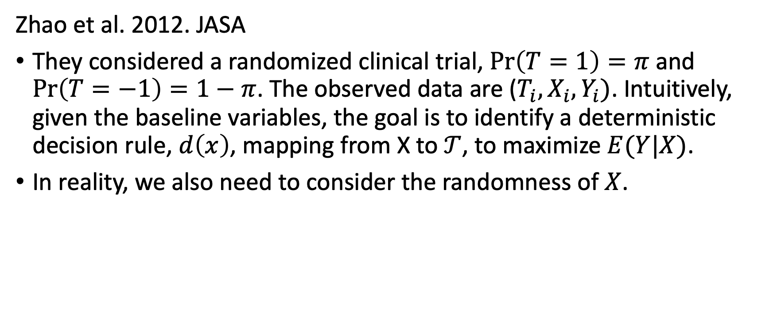
(3) Directly optimize treatment decision rule
Zhao et al. 2012. JASA
They considered a randomized clinical trial, $\operatorname{Pr}\left(T=1\right)=π$ and $\operatorname{Pr}\left(T=−1\right)=1−π$. The observed data are ($T_{i},X_{i}, Y_{i})$. Intuitively, given the baseline variables, the goal is to identify a deterministic decision rule, $d\left(x\right)$, mapping from X to $𝒯$, to maximize $E(Y|X)$.
In reality, we also need to consider the randomness of $X$.

Slide 21
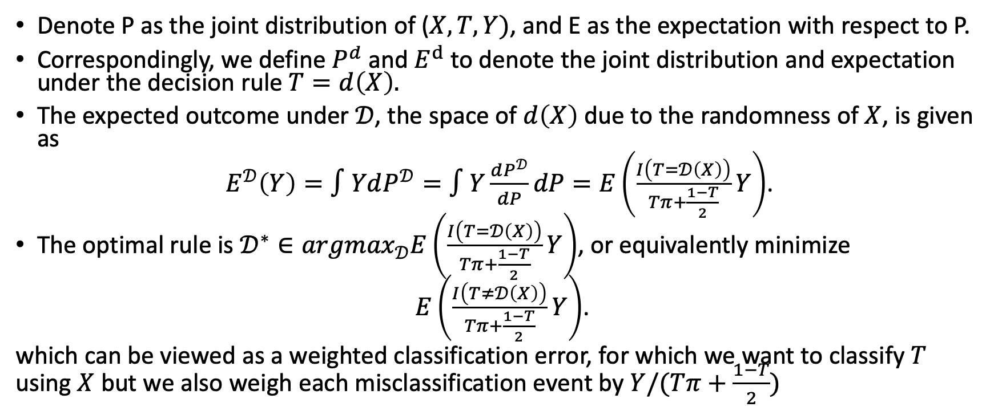
Zhao et al. 2012. JASA
Denote P as the joint distribution of ($X, T, Y)$, and E as the expectation with respect to P.
Correspondingly, we define $P^{d}$and $E^{d}$to denote the joint distribution and expectation under the decision rule $T=d\left(X\right).$
The expected outcome under $𝒟$, the space of $d\left(X\right)$ due to the randomness of $X$, is given as
$E^{𝒟}\left(Y\right)=∫YdP^{𝒟}=∫Y\frac{dP^{𝒟}}{dP}dP=E\left(\frac{I\left(T=𝒟\left(X\right)\right)}{Tπ+\frac{1−T}{2}}Y\right)$.
The optimal rule is $𝒟^{∗}∈{argmax}_{𝒟}E\left(\frac{I\left(T=𝒟\left(X\right)\right)}{Tπ+\frac{1−T}{2}}Y\right)$, or equivalently minimize
$E\left(\frac{I\left(T≠𝒟\left(X\right)\right)}{Tπ+\frac{1−T}{2}}Y\right)$.
which can be viewed as a weighted classification error, for which we want to classify $T$ using $X$ but we also weigh each misclassification event by $Y/(Tπ+\frac{1−T}{2})$

Slide 22
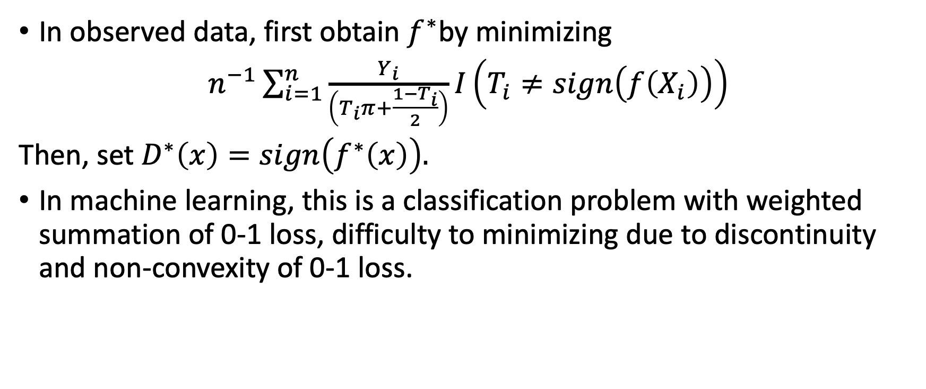
Zhao et al. 2012. JASA (con’d)
In observed data, first obtain $f^{∗}$by minimizing
$n^{−1}\sum_{i=1}^{n}{\frac{Y_{i}}{\left(T_{i}π+\frac{1−T_{i}}{2}\right)}I\left(T_{i}≠sign\left(f\left(X_{i}\right)\right)\right)}$
Then, set $D^{∗}\left(x\right)=sign\left(f^{∗}\left(x\right)\right).$
In machine learning, this is a classification problem with weighted summation of 0-1 loss, difficulty to minimizing due to discontinuity and non-convexity of 0-1 loss.

Slide 23
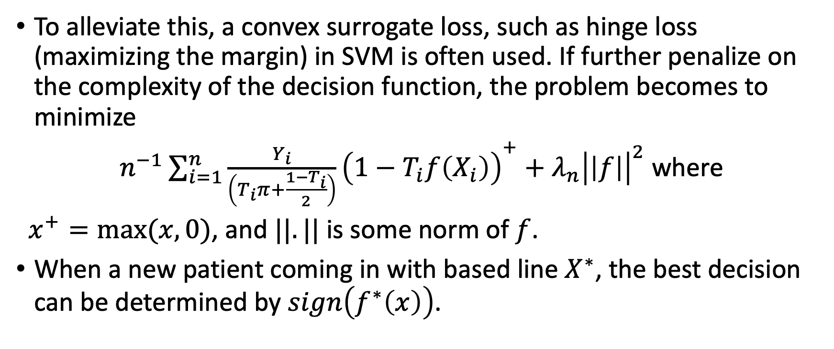
Zhao et al. 2012. JASA (con’d)
To alleviate this, a convex surrogate loss, such as hinge loss (maximizing the margin) in SVM is often used. If further penalize on the complexity of the decision function, the problem becomes to minimize
$n^{−1}{\sum_{i=1}^{n}{\frac{Y_{i}}{\left(T_{i}π+\frac{1−T_{i}}{2}\right)}\left({1−T}_{i}f\left(X_{i}\right)\right)}}^{+}+λ_{n}{\left|\left|f\right|\right|}^{2}$ where
$x^{+}=max⁡(x, 0)$, and $||.||$ is some norm of $f$.
When a new patient coming in with based line $X^{∗}$, the best decision can be determined by $sign\left(f^{∗}\left(x\right)\right)$.

Slide 24
Part 3. Our proposal
We are interested in the interactions among gene, baseline variables, and treatment.
We want to identify subgroups, as there are too many interactions involved and test will lack of power.
We believe subgroups should be determined by genomics profiles and baseline variables simultaneously.

Slide 25

Our model
Baseline variables
Gene expression
X
G
$Y_{i}|z_{i}=k∼N(α_{k}+β_{k}^{′}x_{i}+γ_{k}T_{i}+θ_{K}{′g}_{i}, σ_{k}^{2})$
$Φ\left(Pr\left(z_{i}=k\right)\right)=η^{′}x_{i}+ξ^{′}g_{i}$
Feature selection on $θ_{k}$ and $ξ$.
T
Z
treatment
Latent subgroup index
Y
outcome

